Slide 1

HAND-TRACKING COMPUTER CONTROL
Full Name | ID
Bùi Khắc Chiến | 20220059

Slide 2
01
02
TABLE OF CONTENTS
03
04
Introduction
Problem Description
Goals and Targets
Dataset & Evaluation
Dataset & Data Preprocessing
Evaluation Criteria
Methodology
DSCNet
MSSTNET
3D Resnet-50
TSM+STMEM
Result
05
Application
06
Conclusion

Slide 3
01
Introduction
Introduction
Dataset & Evaluation
Methodology
Result
Conclusion
01

Slide 4
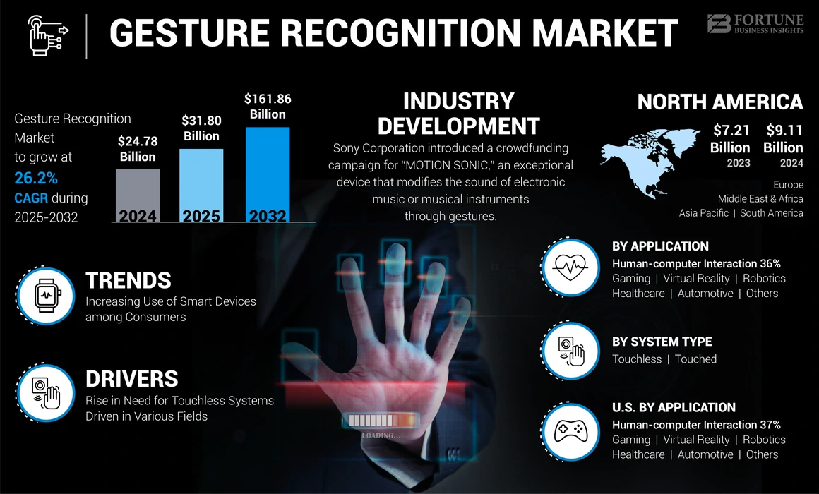
Problem description
Introduction
Dataset & Evaluation
Methodology
Result
Conclusion
02

Slide 5
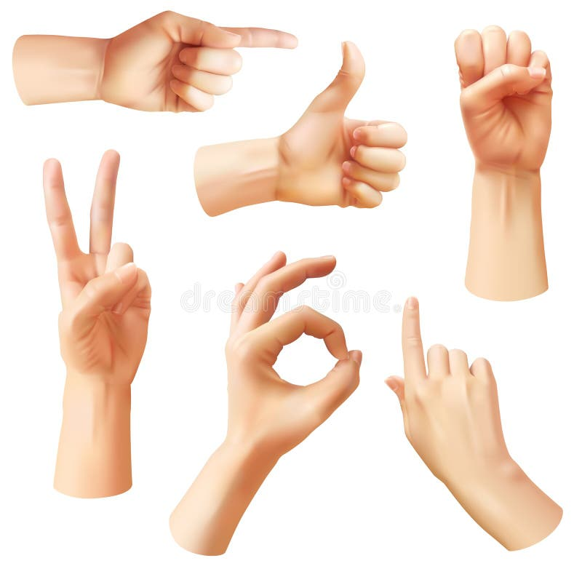
Problem description
Preprocessing
MODEL
Predict
Predicted Action
Dear PyGUI
Control Youtube
Map: <Action, Shortcut>
Video Input (Webcam)
Introduction
Dataset & Evaluation
Methodology
Result
Conclusion
03

Slide 6
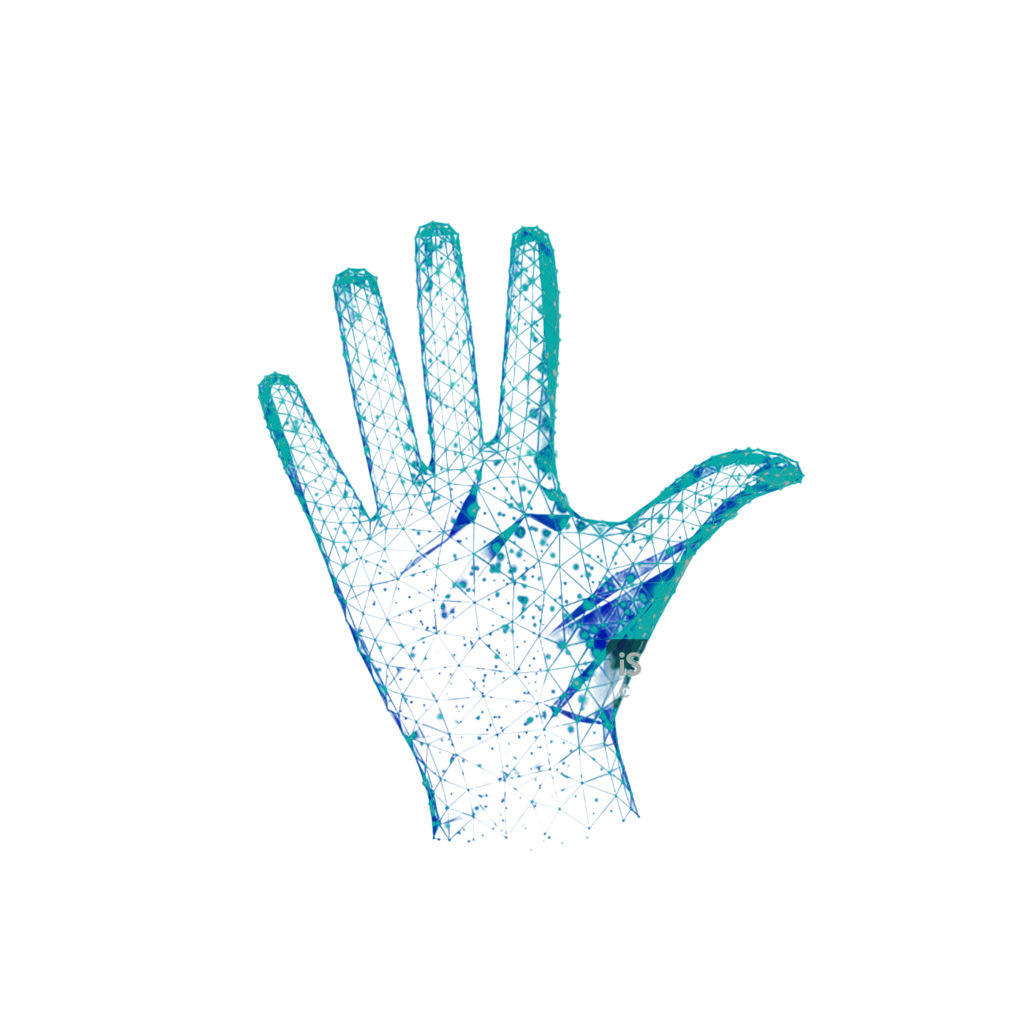
Goal & Target
Primary Goal
Establish an Effective Pipeline
Understand Landmark Extraction
Analyze the framework
Secondary Goal
Ensure System Robustness
Target Objective
Develop a Hand-Tracking Computer Control Application
Explore Cross-Field Applications
Introduction
Dataset & Evaluation
Methodology
Result
Conclusion
04

Slide 7
02
Dataset & Evaluation
Introduction
Dataset & Evaluation
Methodology
Result
Conclusion
05

Slide 8
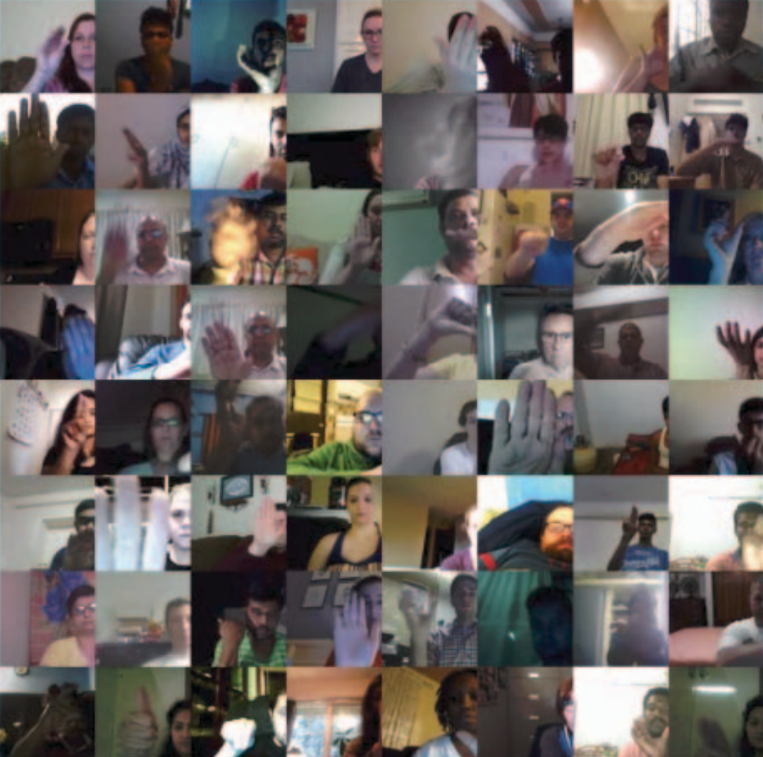
Dataset
Dataset: 20BN – Jester (subset of JESTER dataset)
Characteristics: A large, densely annotated video dataset of predefined hand gestures captured via laptop or webcam.
Structure:
3 main folders:
Train (50.400 directories)
Validation (7.047 directories)
Test (6.981 directories)
3 annotation files:
Train.csv
Validation.csv
Test.csv
Labels: 27 gesture classes (Stop sign, Thumb up…).
Each directory contains 37 frames of single gesture video
Mapping
<Video_id, Gesture label>
Examples of videos from our dataset
Introduction
Dataset & Evaluation
Methodology
Result
Conclusion
06

Slide 9
Dataset
For the purpose of integrating gesture control with the YouTube application,
we selected 18 specific gesture labels
No. | Label | Functionality | Keyboard Shortcut
1 | Doing other things | X | X
2 | No gesture | X | X
3 | Rolling Hand Backward | Seek to previous chapter | Ctrl + <--
4 | Rolling Hand Forward | Seek to next chapter | Ctrl + -->
5 | Shaking Hand | Stop detect gesture | X
6 | Sliding Two Fingers Down | Decrease Volume | Arrow up
7 | Sliding Two Fingers Left | Increase Volume | Arrow down
8 | Sliding Two Fingers Right | Seek forward 5 secs | -->
9 | Sliding Two Fingers Up | Seek backward 5 secs | <--
10 | Stop Sign | Toggle play/pause | K
11 | Swiping Down | Toggle captions | C
12 | Swiping Left | Switch to previous tab | Alt + <--
13 | Swiping Right | Switch to next tab | Alt + -->
14 | Swiping Up | Next video | shift + n
15 | Thumb Down | Toggle mute | M
16 | Thumb Up | Toggle full screen | f
17 | Turning Hand Clockwise | Increase playback rate | <
18 | Turning Hand Counterclockwise | Decrease playback rate | >
Introduction
Dataset & Evaluation
Methodology
Result
Conclusion
07

Slide 10
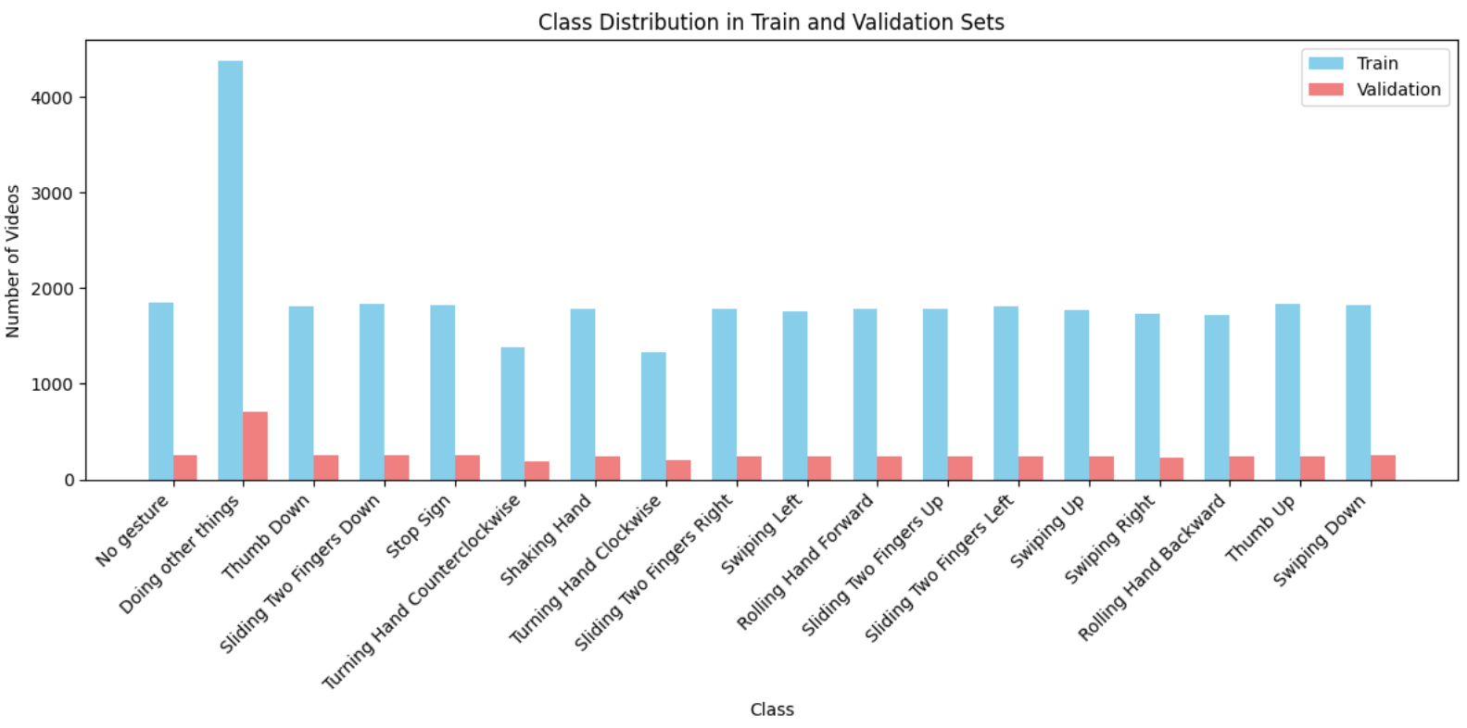
Dataset
Class distribution of gesture class in Train and Validation sets
Introduction
Dataset & Evaluation
Methodology
Result
Conclusion
08

Slide 11

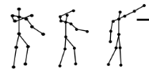
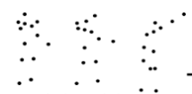
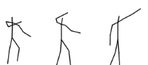
Data Preprocessing
Goal: Extract human skeletal features from RGB frames
Cropped RGB frames
RGB frames
RGB-based model
(x,y,z)
Skeleton-based model
Skeleton joints
Skeleton bones
Introduction
Dataset & Evaluation
Methodology
Result
Conclusion
09

Slide 12
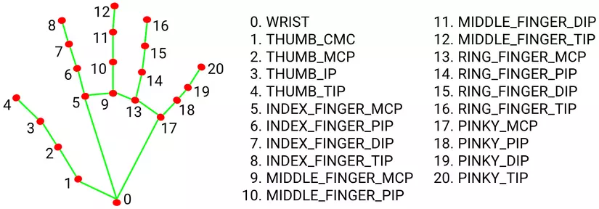
Data Preprocessing
For hand, we extract 21 key points and their connections per hand
For pose, we only focus on 6 upper-body landmarks:
Left/Right Shoulder, Left/Right Elbow, and Left/Right Wrist.
T = 37: number of frames/ video
Output: Tensor with shape (T, V, C)
V = 48: total number of joints
C = 3: 3D coordinates (x, y, z) of each landmark
Introduction
Dataset & Evaluation
Methodology
Result
Conclusion
10

Slide 13
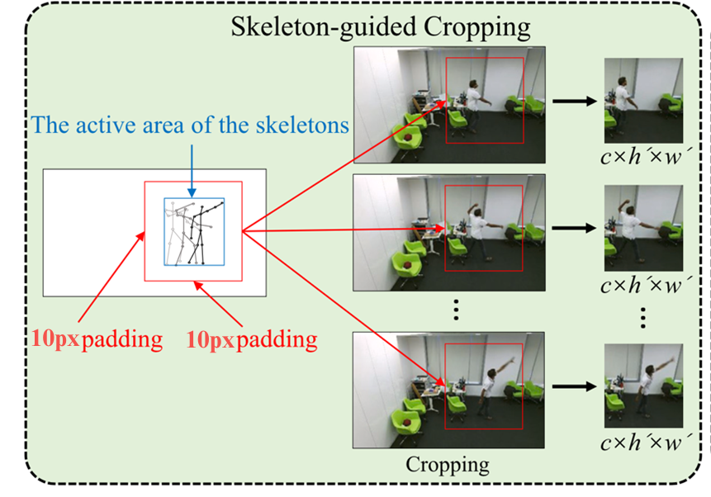
Data Preprocessing
Skeleton-guided RGB frame cropping
Based on skeleton coordinate:
active region of the skeleton across all frame
[min(X), max(X)] and [min(Y), max(Y)]
Cropping intervals for horizontal and vertical axes
[max(min(X) – 10, 1), min(max(X) + 10, w)]
and
[max(min(Y) – 10, 1), min(max(Y) + 10, h)]
Introduction
Dataset & Evaluation
Methodology
Result
Conclusion
11

Slide 14
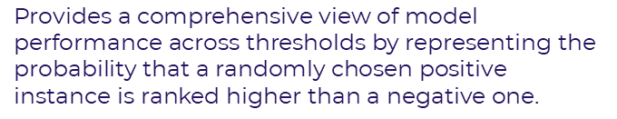

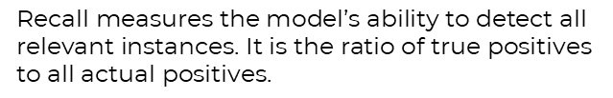
Evaluation
ACCURACY
PRECISION
The ratio of correctly predicted actions to the total number of predictions.
Focuses on the quality of positive predictions.
It is the proportion of true positive predictions among all positive predictions
$$\text{Accuracy}\text{ = }\frac{\text{TP}\text{+}\text{TN}}{\text{TP}\text{+}\text{TN}\text{+}\text{FP}\text{+}\text{FN}}$$
$$\text{Precision}\text{ = }\frac{\text{TP}}{\text{TP}\text{+}\text{FP}}$$
RECALL
AREA UNDER THE ROC CURVE (AUC)
$$\text{Recall} \text{measures} \text{the} \text{model}\text{’}\text{s} \text{ability} \text{to} \text{detect} \text{all} \text{relevant} \text{instances}\text{. }\text{It} \text{is} \text{the} \text{ratio} \text{of} \text{true} \text{positives} \text{to} \text{all} \text{actual} \text{positives}\text{.}$$
$$\text{Provides} \text{a} \text{comprehensive} \text{view} \text{of} \text{model} \text{performance} \text{across} \text{thresholds} \text{by} \text{representing} \text{the} \text{probability} \text{that} \text{a} \text{randomly} \text{chosen} \text{positive} \text{instance} \text{is} \text{ranked} \text{higher} \text{than} \text{a} \text{negative} \text{one}\text{.}$$
$$\text{R}\text{ecall}\text{ = }\frac{\text{TP}}{\text{TP}\text{+}\text{FN}}$$
Introduction
Dataset & Evaluation
Methodology
Result
Conclusion
12

Slide 15
03
METHODOLOGY
Introduction
Dataset & Evaluation
Methodology
Result
Conclusion
13

Slide 16
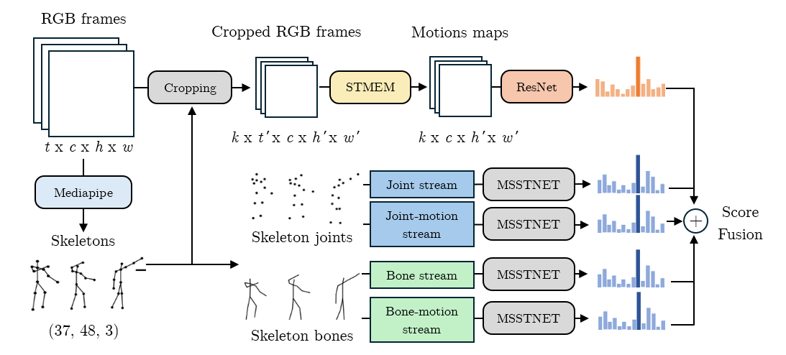
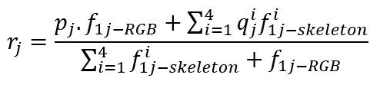
DSCNET
Dense-Sparse Complementary Network (DSCNET)
The ensemble probability for class j is computed as:
Introduction
Dataset & Evaluation
Methodology
Result
Conclusion
14

Slide 17
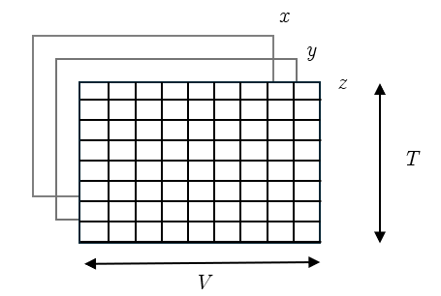
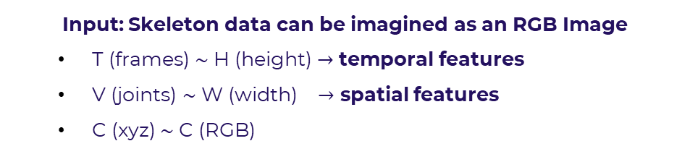
MSSTNET (Multi-scale spatial-temporal convolutional neural network
Input: Skeleton data can be imagined as an RGB Image
T (frames) $\sim$ H (height) $→$ temporal features
V (joints) $\sim$ W (width) $→$ spatial features
C (xyz) $\sim$ C (RGB)
Illustration of skeleton data
Introduction
Dataset & Evaluation
Methodology
Result
Conclusion
15

Slide 18
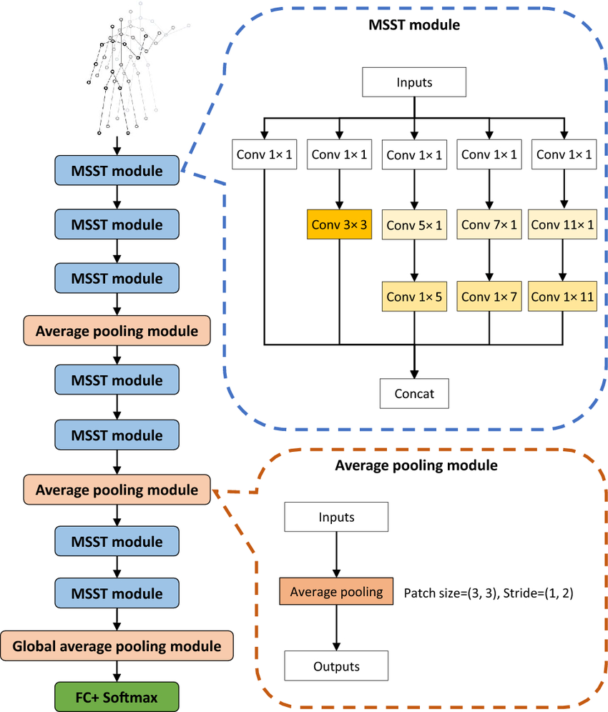
MSSTNET
MSST Module
Input flows through 5 parallel branches, each starting with a 1×1 convolution (dimension reduction).
Branch designs vary by receptive field:
Branch 1: 1×1 conv (preserves spatial info)
Branch 2: 1×1 → 3×1 + 1×3 convs (small receptive field)
Branch 3: 1×1 → 5×1 + 1×5 convs (medium)
Branch 4: 1×1 → 7×1 + 1×7 convs (large)
Branch 5: 1×1 → 11×1 + 1×11 convs (largest)
All outputs concatenated into final feature maps.
Batch Norm + ReLU after each convolution.
Strength
Captures both local features and global context in spatial and temporal dimensions.
Reduces computational cost while maintaining strong representational capacity.
Result
Conclusion
16

Slide 19
MSSTNET
Module | Stride | 1 x 1 | 3 x 3 | 5 x 1 1 x 5 | 7 x 1 1 x 7 | 11 x 1 1 x 11 | Input size
MSST module 1 | (1, 1) | 44 | 60 | 60 | 60 | 60 | (T, V, 3)
MSST module 2 | (1, 1) | 48 | 80 | 80 | 80 | 80 | (T, V, 284)
MSST module 3 | (1, 1) | 56 | 120 | 120 | 120 | 120 | (T, V, 288)
Avg pool | (1, 2) |  |  |  |  |  | (T, V, 536)
MSST module 4 | (1, 1) | 160 | 160 | 160 | 160 | 160 | (T, V/2, 536)
MSST module 5 | (2, 1) | 72 | 200 | 200 | 200 | 200 | (T, V/2, 800)
Avg pool | (1, 2) |  |  |  |  |  | (T/2, V/2, 872)
MSST module 6 | (1, 1) | 240 | 240 | 240 | 240 | 240 | (T/2, V/4, 872)
MSST module 7 | (1, 1) | 320 | 320 | 320 | 320 | 320 | (T/2, V/4, 1200)
Global Avg pool | (1, 1) |  |  |  |  |  | (T/2, V/4, 1600)
Full Connection |  |  |  |  |  |  | (1, 1, 1600)
Architecture of MSSTNET
Introduction
Dataset & Evaluation
Methodology
Result
Conclusion
17

Slide 20

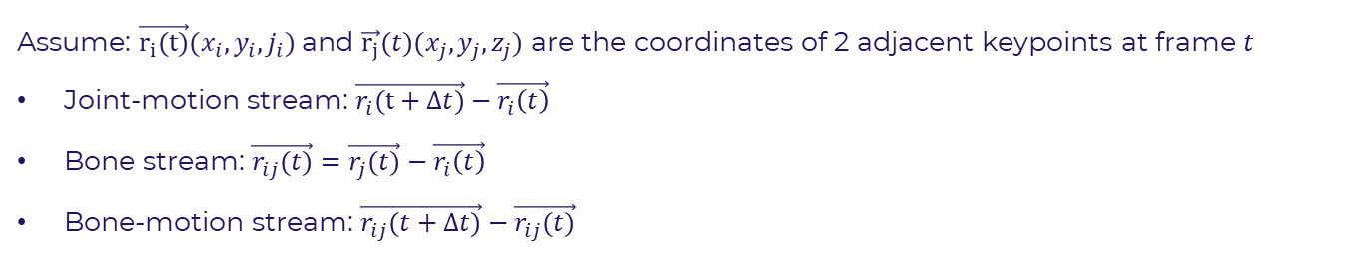
Training MSSTNET
RGB frames
Joint stream
MSSTNET
Skeleton joints
Joint-motion stream
MSSTNET
Mediapipe
+
Bone stream
MSSTNET
Skeleton bones
Bone-motion stream
MSSTNET
Assume: $\vec{r_{i}(t)}(x_{i},y_{i}, j_{i})$ and $\vec{r_{j}}(t)(x_{j}, y_{j},z_{j})$ are the coordinates of 2 adjacent keypoints at frame $t$
Joint-motion stream: $\vec{r_{i}(t+∆t)}−\vec{r_{i}\left(t\right)}$
Bone stream: $\vec{r_{ij}(t)}=$ $\vec{r_{j}(t)}−\vec{r_{i}\left(t\right)}$
Bone-motion stream: $\vec{r_{ij}(t+∆t)}−\vec{r_{ij}(t)}$
Introduction
Dataset & Evaluation
Methodology
Result
Conclusion
18

Slide 21
Training MSSTNET
Model | Accuracy | Precision | Recall | F1 Score | AUC
Joint stream | 0.8906 | 0.8920 | 0.8906 | 0.8904 | 0.9952
Joint motion stream | 0.8877 | 0.8910 | 0.8877 | 0.8879 | 0.9952
Bone stream | 0.8906 | 0.8913 | 0.8906 | 0.8904 | 0.9952
Bone motion stream | 0.8611 | 0.8633 | 0.8611 | 0.8606 | 0.9947
Ensemble | 0.9044 | 0.9062 | 0.9044 | 0.9043 | 0.9954
Evaluation of each model performance
Introduction
Dataset & Evaluation
Methodology
Result
Conclusion
19

Slide 22
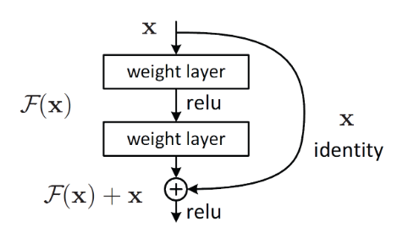
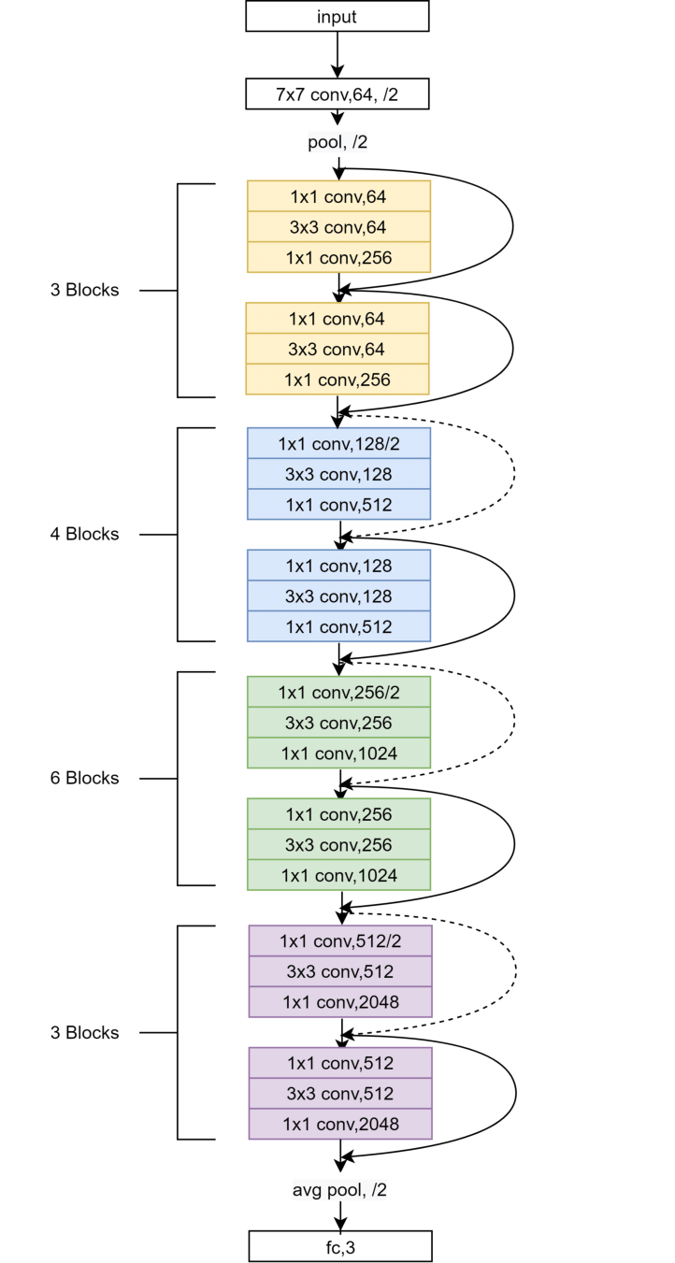
3D RESNET-50
Resnet – Residual Network.
Solving vanishing and exploding gradient in deep neural network.
Using shortcut connection.
Resnet-50 with 50 learnable layers for image classification
Introduction
Dataset & Evaluation
Methodology
Result
Conclusion
20

Slide 23
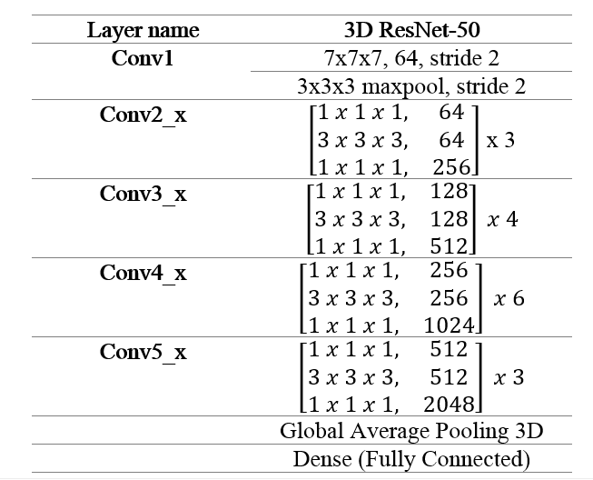
3D RESNET-50
Inspiration of 2D Resnet-50
replacing convolutional and pooling layer with the 3D counterparts
4 main Residual blocks
Input size [32, 128, 128, 3]
Over 40 million learnable parameters
Training over 60 hours for 48 epochs
D Resnet architecture
Fc, 18
2D Resnet architecture
Introduction
Dataset & Evaluation
Methodology
Result
Conclusion
21

Slide 24
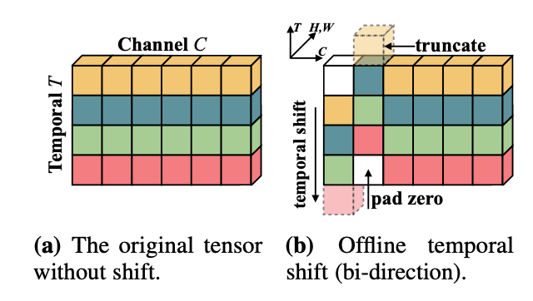
TSM (Temporal Shift Module ) with 2D_Resnet backbone
Temporal Shift Module
Shifts 1/8 of the channels forward in time
Another 1/8 backward
Leaves the rest unchanged
→ Temporal information exchange across frames
→ Insert into ResNet2D : model motion patterns across adjacent frames while maintaining the efficiency and optimization benefits
Introduction
Dataset & Evaluation
Methodology
Result
Conclusion
22

Slide 25
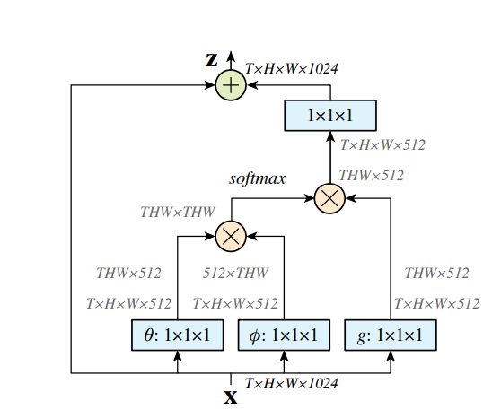

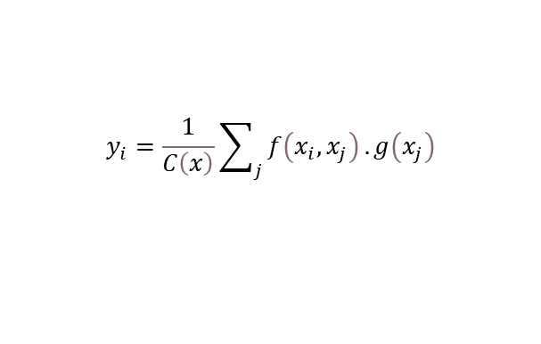
Non-local module
Non-local operation computes the response at a given position as a weighted sum of the features at all positions in the input
$$y_{i}=\frac{1}{C\left(x\right)}\sum_{j}{f\left(x_{i},x_{j}\right)}.g\left(x_{j}\right)$$
Output at position i
transformed representation the input features at location j
affinity score between location i and j
Non-local block:
to incorporate this non-local operation into any existing model
$$z_{i}=W_{z}y_{i}+x_{i}$$
Introduction
Dataset & Evaluation
Methodology
Result
Conclusion
23

Slide 26
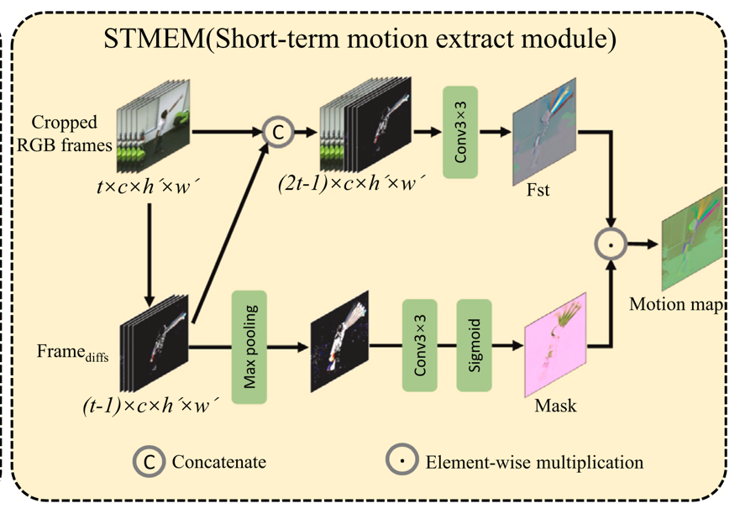
STMEM (Short-Term Motion Extract Module)
Problem: Dense RGB frame inputs are computationally expensive.
Solution: Use Short-Term Motion Extract Module (STMEM) to compress dense sequences into sparse motion-aware representations.
Benefits:
Significantly reduces data volume.
Maintains key spatial and motion features.
End-to-end trainable and compatible with backbone networks.
Introduction
Dataset & Evaluation
Methodology
Result
Conclusion
24

Slide 27
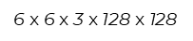
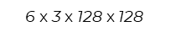
STMEM + TSM-Resnet implementation
Removed last frame (→ 36 frames) for clean segmenting.
Applied data augmentation: brightness, contrast, color jitter.
Frames resized to 128×128, stacked into video tensor.
Mon-local blocks to layers 2 & 3 of Resnet
Pretrained ResNet-50 on ImageNet with recalculated weight to adapt for RGB difference inputs
Cropped RGB frames
Motions maps
STMEM
TSM
ResNet + Non-local
$$\text{6} \text{x} \text{6} \text{x} \text{3} \text{x} \text{128 }\text{x} \text{128}$$
$$\text{6} \text{x} \text{3} \text{x} \text{128 }\text{x} \text{128}$$
Introduction
Dataset & Evaluation
Methodology
Result
Conclusion
25

Slide 28
04
Result and Discussion
Introduction
Dataset & Evaluation
Methodology
Result
Conclusion
26

Slide 29
Result
Model | Accuracy | Precision | Recall | F1 Score | AUC
STMEM + TSM-Resnet | 0.9098 | 0.9132 | 0.9098 | 0.9095 | 0.9966
DSCNet Ensemble | 0.9095 | 0.9108 | 0.9095 | 0.9094 | 0.9939
MSSTNET (Ensemble) | 0.9042 | 0.9059 | 0.9042 | 0.9041 | 0.9954
3D ResNet-50 | 0.7713 | 0.8003 | 0.7398 | 0.7687 | 0.9723
Introduction
Dataset & Evaluation
Methodology
Result
Conclusion
27

Slide 30
Discussion: the best model
Model | Accuracy | Precision | Recall | F1 Score | AUC
STMEM + TSM-Resnet | 0.9098 | 0.9132 | 0.9098 | 0.9095 | 0.9966
DSCNet Ensemble | 0.9095 | 0.9108 | 0.9095 | 0.9094 | 0.9939
MSSTNET (Ensemble) | 0.9042 | 0.9059 | 0.9042 | 0.9041 | 0.9954
3D ResNet-50 | 0.7713 | 0.8003 | 0.7398 | 0.7687 | 0.9723
Best model:
STMEM+TSM-ResNet
Outperforming the standard 3DResNet
Dataset & Evaluation
Introduction
Dataset & Evaluation
Methodology
Methodology
Result
Result
Conclusion
Conclusion
28

Slide 31
Discussion: the combined model
Model | Accuracy | Precision | Recall | F1 Score | AUC
STMEM + TSM-Resnet | 0.9098 | 0.9132 | 0.9098 | 0.9095 | 0.9966
DSCNet Ensemble | 0.9095 | 0.9108 | 0.9095 | 0.9094 | 0.9939
MSSTNET (Ensemble) | 0.9042 | 0.9059 | 0.9042 | 0.9041 | 0.9954
3D ResNet-50 | 0.7713 | 0.8003 | 0.7398 | 0.7687 | 0.9723
Not the best
Reasons behind:
RGB model is already good
The dataset favors simpler model
Fusion technique
Dataset & Evaluation
Introduction
Dataset & Evaluation
Methodology
Methodology
Result
Result
Conclusion
Conclusion
29

Slide 32
Discussion: comparison with SOTA
SOTA models:
DirecFormer (CVPR 2022), an RGB-based Transformer model, accuracy: 98.15%
(MFFs) / DRX3D (CVPRW 2018), CNN + RGB + Optical flow accuracy: 96.3%
Model | Accuracy | Precision | Recall | F1 Score | AUC
STMEM + TSM-Resnet | 0.9098 | 0.9132 | 0.9098 | 0.9095 | 0.9966
DSCNet Ensemble | 0.9095 | 0.9108 | 0.9095 | 0.9094 | 0.9939
MSSTNET (Ensemble) | 0.9042 | 0.9059 | 0.9042 | 0.9041 | 0.9954
3D ResNet-50 | 0.7713 | 0.8003 | 0.7398 | 0.7687 | 0.9723
Dataset & Evaluation
Introduction
Dataset & Evaluation
Methodology
Methodology
Result
Result
Conclusion
Conclusion
30

Slide 33
05
Application
31

Slide 34
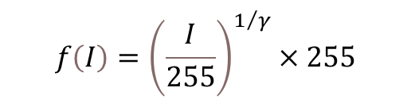
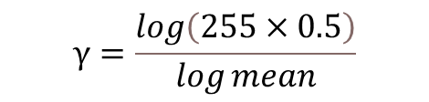
Image enhancement
CLAHE (Contrast Limited Adaptive Histogram Equalization)
Gamma Correction:
$$f\left(I\right)={\left(\frac{I}{255}\right)}^{1/γ}×255$$
$$γ=\frac{\log\left(255×0.5\right)}{\log{mean}}$$
Where:
mean is average brightness
Turn to LAU
CLAHE
Turn to HSV
Gamma correction
Better contrast and brightness
Keyboard control: keyboard module
GUI toolkit: Dear PyGUI
Control Youtube Tool
32

Slide 35
06
Conclusion
Introduction
Dataset & Evaluation
Methodology
Result
Conclusion
33

Slide 36
Three Main Types Of Models
RGB-based (STMEM + TSM-Resnet)
Skeleton-based (MSSTNET)
Combined model (DSCNet)
Hand tracking computer control application
Model Type | Action Type |  | Infer Time
 | Dynamic actions | Static Actions
RGB-based model | Well | Not Good (Better when there’re motions) | Fast
Skeleton-based model | Well | Well | Slow
Combined model | Well | Well | Slow
Potential Improvements
Try Transformer-based models.
Explore way to combine videos and skeleton data.
More useful computer controlling application, not just for YouTube
Introduction
Dataset & Evaluation
Methodology
Result
Conclusion
34

Slide 37
THANK YOU FOR LISTENING
35

